Slide 1
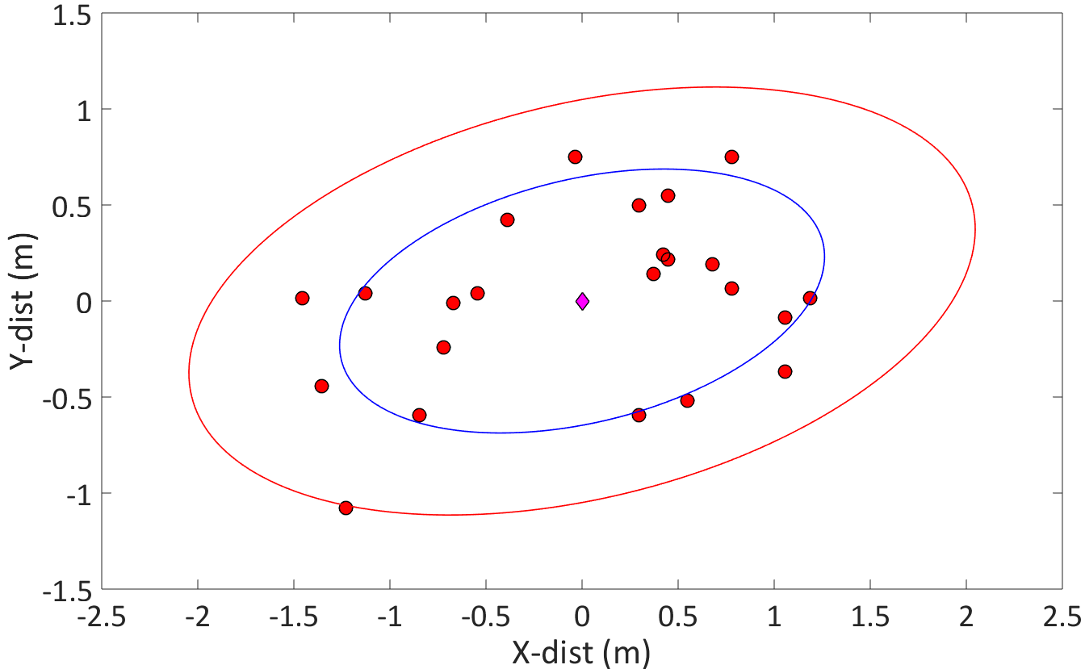
2nd S.D. Ellipse
Mean
Dropped Location
1st S.D. Ellipse

